Slide 1
Conversion
1.Binary to Decimal.
2.Decimal to Binary.
3.Hexadecimal to Binary.
4.Binary to Hexadecimal.
5.Hexadecimal to Decimal.
6.Decimal to Hexadecimal.
CIT- 1 Year CIT-134

Slide 2
Conversion
1 - Binary to Decimal.
2 - Decimal to Binary.
CIT- 1 Year CIT-134

Slide 3
1- Binary to decimal conversion
Binary to decimal conversion explains the conversion of a binary number (base-2) to an equivalent decimal number (base-10). In Mathematics, a number system is used for expressing numbers. It is a way to represent numbers. The four different types of number system are:
Binary Number System (Base-2)
Octal Number System (Base-8)
Decimal Number System (Base-10)
Hexadecimal Number System (Base-16)
Convert the binary number (1101)₂ into a decimal number.
1 × 2³ + 1 × 2² + 0 × 2¹ + 1 × 2⁰
= 8 + 4 + 0 + 1
= 13
CIT- 1 Year CIT-134

Slide 4
Q.1: Convert the binary number 1001 to a decimal number.
Solution: Given, binary number = 1001₂
Hence, using the binary to decimal conversion formula, we have:
1001₂ = (1 × 2³) + (0 × 2²) + (0 × 2¹) + (1 × 2⁰)
= 8 + 0 + 0 + 1
= (9)₁₀
Q.2: Convert 1101001₂ into an equivalent decimal number.
Solution: Using binary to decimal conversion method, we get;
(1101001)₂ = (1 × 2⁶) + (1 × 2⁵) + (0 × 2⁴) + (1 × 2³) + (0 × 2²) + (0 × 2¹) + (1 × 2⁰)
= 64 + 32 + 0 + 8 + 0 + 0 + 1
= (105)₁₀
Q.3: Convert (11110111)₂ into base-10 number system.
Solution: Using binary to decimal conversion method, we get;
(11110111)₂ = (1 × 2⁷) + (1 × 2⁶) + (1 × 2⁵) + (1 × 2⁴) + (0 × 2³) + (1 × 2²) + (1 × 2¹) + (1 × 2⁰)
= 128 + 64 + 32 + 16 + 0 + 4 + 2 + 1
= (247)₁₀
CIT- 1 Year CIT-134

Slide 5
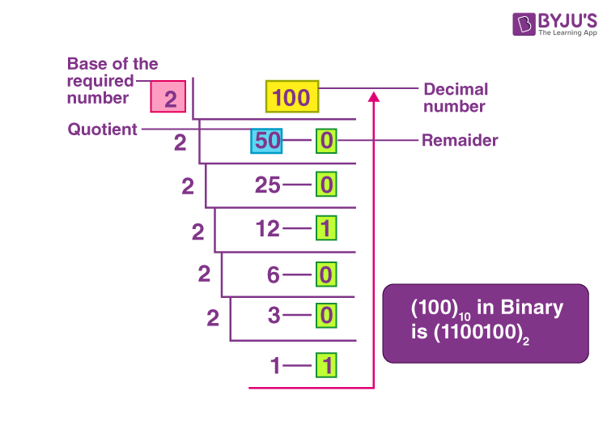
2- decimal to binary conversion
Convert the decimal number (100)₁₀ into a binaryl number.
CIT- 1 Year CIT-134

Slide 6
Q . 1:
Convert 160₁₀ to binary Number
Q . 2:
Convert 17₁₀ into a binary number
Q . 3:
convert the given decimal number 294 into a binary number.
CIT- 1 Year CIT-134

